Slide 1
Software Engineering and Architecture
SCM Collaboration

Slide 2
Concepts II: Collaboration
Theory of SCM

Slide 3
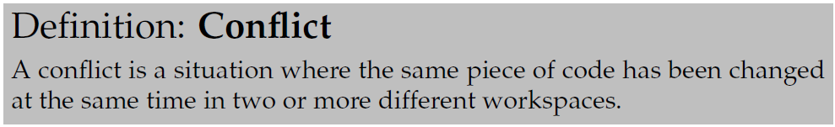
Collaboration
What do you get if you put two developers on a code base?
Answer: Conflicts!
I.e. Arne and Bente check-out version 17 of Receipt.java
And both edit and change the same part of the code!
Question: Whose edits are the correct ones to check-in?

Slide 4
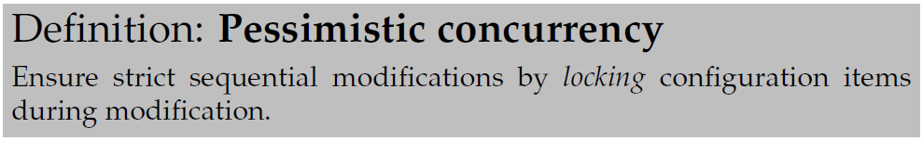
Concurrency
You ask permission by the SCM system to edit a file
If granted, you ‘own’/’lock’ the file
Anyone else will be rejected!
Outcome: No conflicts ever occur…
Popular in early SCM systems, like RCS

Slide 5

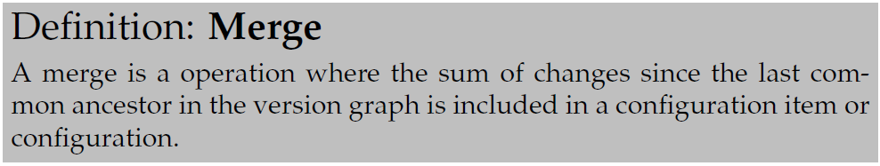
Concurrency
Both may modify any file in their workspace
First to check-in does so as usual
Second to check-in are required to merge in case of merge-conflicts
Review all places where Arne and Bente has made changes in the same code lines

Slide 6
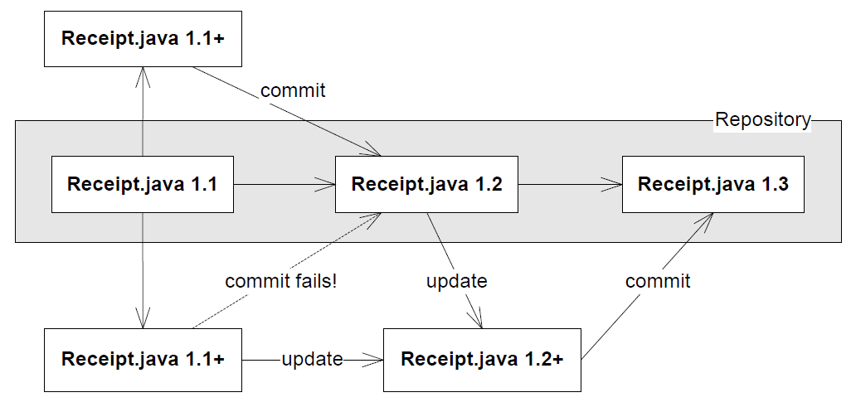
Merging
Merging

Slide 7
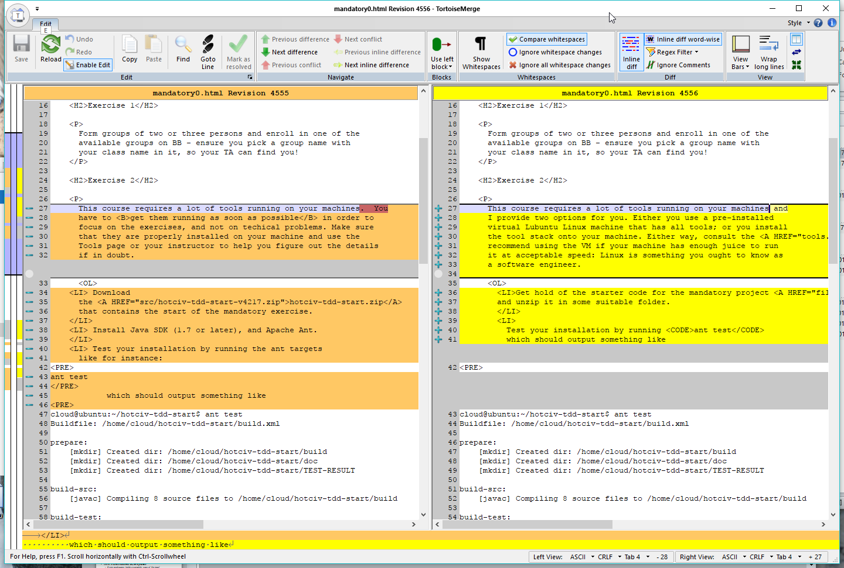
Merging is a Demanding Task!
In case of many merge-conflicts, you need help
Use graphical merge tools!
Built-in
Tortoise SVN
SourceTree
…
WinMerge
WarStory
One man fulltime to handle merge in local company!
Notes:
The screen shot is actually a diff tool from subversion.

Slide 8
Keep Merge-Conflicts Small
WarStory
One man fulltime to handle merge in local company!
Exercise: How to avoid?
By taking small steps!
Check-in often, merge often !!!
Hourly, not monthly!!!
Notes:
The screen shot is actually a diff tool from subversion.

Slide 9
Exercise
SCM systems must handle all aspects of an application
Source code, build scripts, image files, sound files, configuration files…
Which types of files are best handled using
Pessimistic concurrency?
Optimistic concurrency?

Slide 10
So - Status
OK – so what have we got?
Collaboration on configurations by either optimistic or pessimistic concurrency – through locking items or through a merge phase
Basically collaboration management
The team can work together without overwriting code made by others, and are warned when there are conflicting edits
Note: SCM systems can only detect syntactic conflicts!

Slide 11
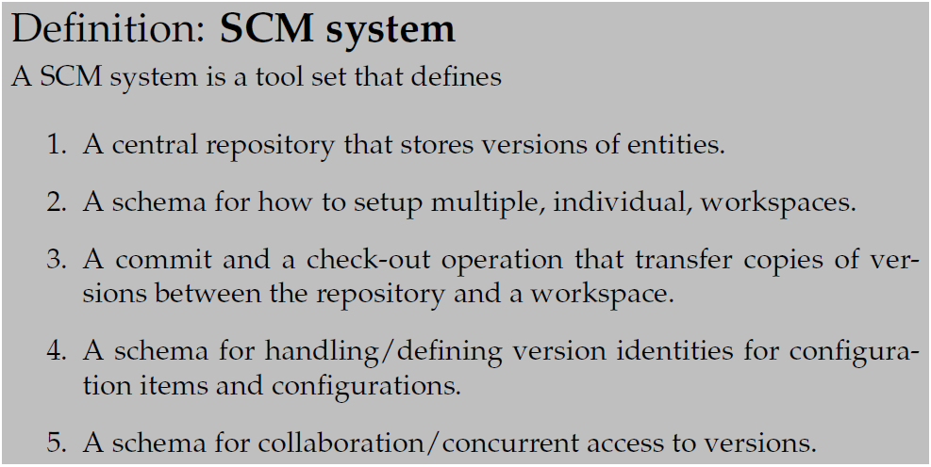
Thus – SCM:

